Slide 1
2015 Conaway Conference
Technical Process Reviews
Construction Administration
Staff Specialists

Slide 2
Traffic and Roadway
Technical Process Reviews
Dan Groh, P. E.
Construction Traffic and Roadway Engineer

Slide 3
Traffic and Roadway TPR’s
614 Maintenance of Traffic
  Night time Paving
  Portable Barrier Connections
Work Zone Speed Zones

Slide 4
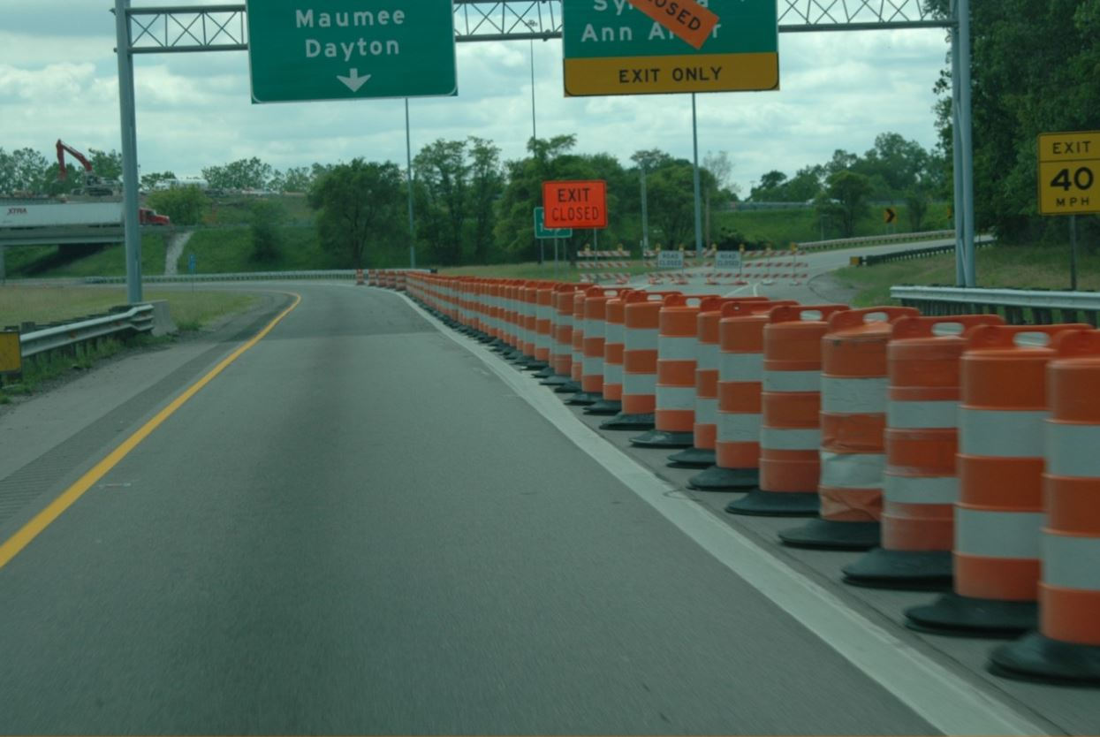
Drum Spacing

Slide 5
MT 95.30, MT 95.31, MT 95.32
13B. Cones may be substituted for drums as follows:
a) Use of cones is permissible for either daytime operation or for nighttime operation, but shall not be used continuously, day and night. Upon completion of work within the work period, the cones shall be removed. They may again be placed on the highway in order to resume work in the following such work period
b) Cones used for daytime traffic control shall have a minimum height of 28“
c) Cones used for nighttime traffic control shall have a
minimum height of 42“
d) Use of cones at night shall be prohibited along tapers
e) Cone spacing at night shall be at a maximum of 40’
f) Where cones are substituted for drums along tangents, intermixing of channelizing devices within the same run will not be permitted. Either cones shall be used for the entire length of the tangent section, or drums shall be used for the entire length

Slide 6

Cone Spacing
Spacing of cones at night

Slide 7

Cone Spacing
Spacing of cones at night

Slide 8
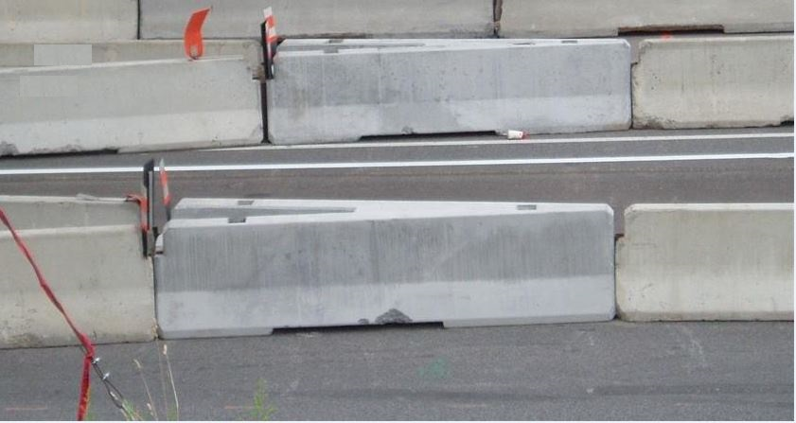
Portable Barrier Connections

Slide 9
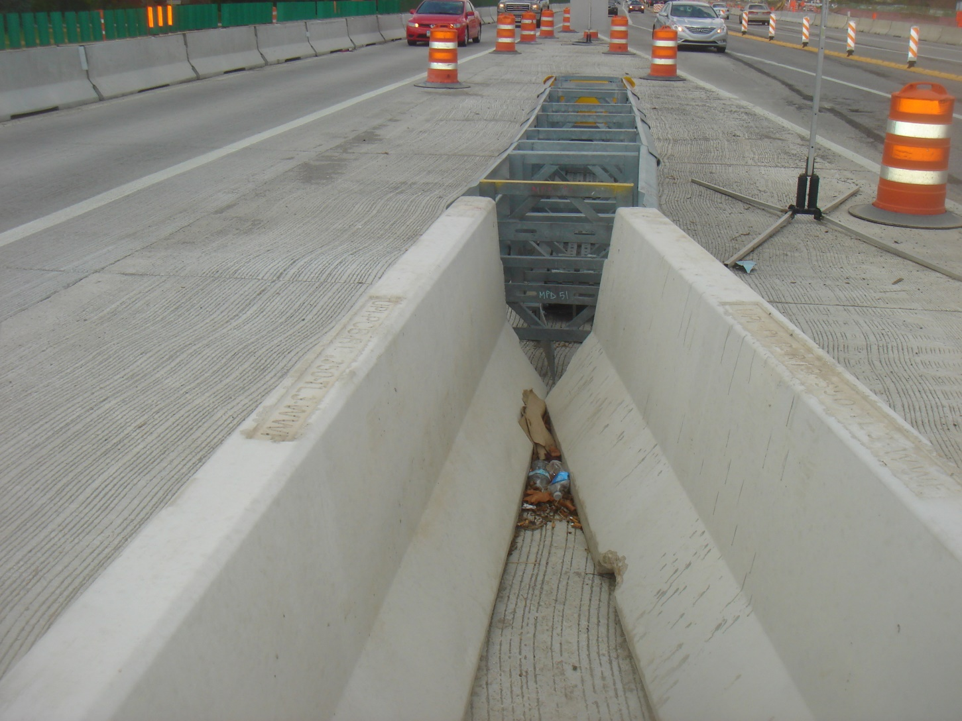
Portable Barrier Connections

Slide 10
Work Zone Speed Zones
What is the difference between “Work Zone Speed Zones (WZSZs)” and “Variable Work Zone Speed Zones (VWZSZs) Using Digital Speed Limit (DSL) Sign Assemblies”?
  WZSZs refers to the process that was published in April of 2011, is still in place, and only includes use of flat sheet speed limit signs. This process applies to WZSZs that remain in place 24/7 as well as ones that change more frequently. In all cases the WZSZ is only to remain in place for as long as the warranting conditions are present. This process did not change with the January 2015 publication

Slide 11
Work Zone Speed Zones
VWZSZ Using DSL Sign Assemblies is for use with a specific subset of WZSZs – the subset of WZSZs that are installed / removed (or covered / uncovered) on a daily basis. They are also only to be used when all of the requirements in Supplemental Specification 808 are met. For more information on DSL Sign Assemblies see “What are Digital Speed Limit (DSL) Sign Assemblies?”

Slide 12
Work Zone Speed Zones
Can we now use DSL Sign Assemblies in work zones?
  As of the January 2015 publication we have now published everything you need to be able to use DSL Sign Assemblies on projects; HOWEVER, we DO NOT RECOMMEND including their use in plans UNTIL THERE IS AT LEAST ONE APPROVED PRODUCT ON THE LIST
  In the meantime, consider using the usual WZSZ process using flat sheet speed limit signs. This WZSZ process is the same as it was prior to the January 2015 publication and can still be used today even for zones where the speed limit will vary on a daily basis

Slide 13
Work Zone Speed Zones
Why aren’t there any products on the DSL Sign Assembly Approved List at this time? What if I go ahead and include the use of DSL Sign Assemblies in the plans anyways?
  To date no manufacturers have submitted to be considered for approval, but we do think at least one will be forthcoming. We will continue to update the approved product list as products are approved. Including use of Digital Speed Limit (DSL) Sign Assemblies in the plans (despite there not being any approved products) could create an unbiddable situation. We recommend not including DSL Sign Assemblies in plans until there is at least one approved product on the list. In the meantime, consider using the WZSZ process using flat sheet speed limit signs
Notes:
To date (2/11/15) no manufacturers have submitted to be considered for approval, but we do think at least one will be forthcoming. We will continue to update the approved product list as products are approved. Including use of Digital Speed Limit (DSL) Sign Assemblies in the plans (despite there not being any approved products) could create an unbiddable situation. We recommend not including DSL Sign Assemblies in plans until there is at least one approved product on the list. In the meantime, consider using the WZSZ process using flat sheet speed limit signs.

Slide 14

Work Zone Speed Zones
Contacts
  Emily Willis, Emily.Willis@dot.state.oh.us or 614-644-8179
  Dan Groh, Dan.Groh@dot.state.oh.us or 614-387-1162
    http://www.dot.state.oh.us/Divisions/Engineering/Roadway/TrafficControl/Pages/MOT.aspx

Slide 15


Questions
Dan Groh, P.E.
Office of Construction Administration
Division of Construction Management
Ohio Department of Transportation
1980 West Broad St (Mail Stop 5190)
Columbus, OH 43223
Phone: 614-387-1162

Slide 16
Earthwork Technical Process Reviews
Stephen Slomski, P. E.
Construction Geotechnical Engineer
10 Specification Items
15 Projects
10 Districts
12 Contractors

Slide 17
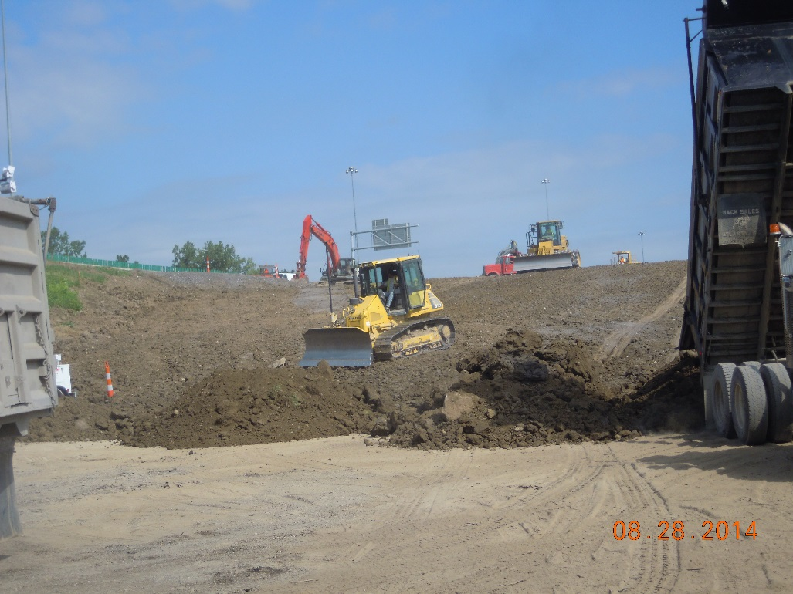
Item 203 – Roadway Excavation And Embankment
3 Projects – 2 Interstates & 1 slide repair
Vegetation & topsoil removed
Proper fill benching & lift thickness
Correct compaction & testing techniques

Slide 18
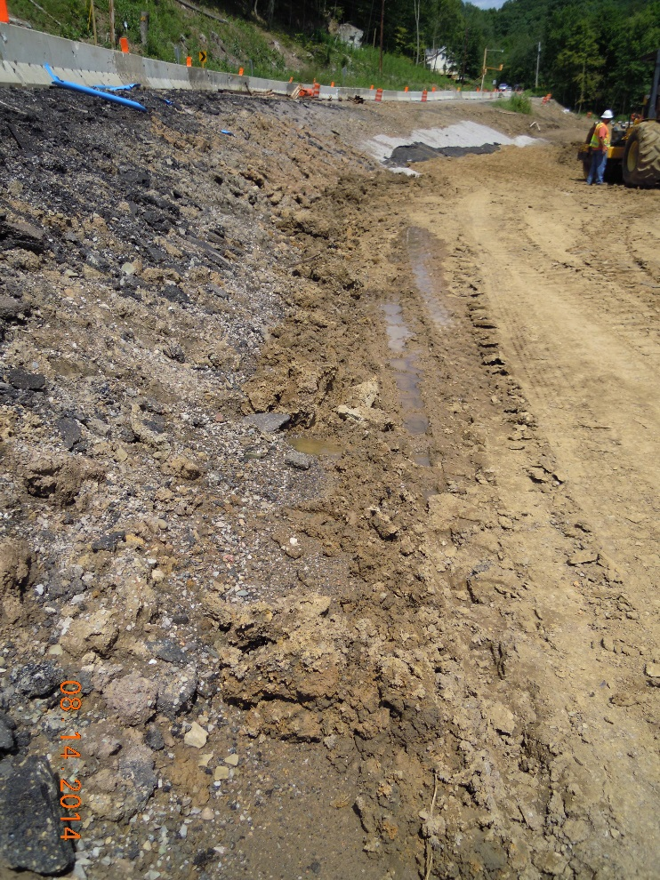
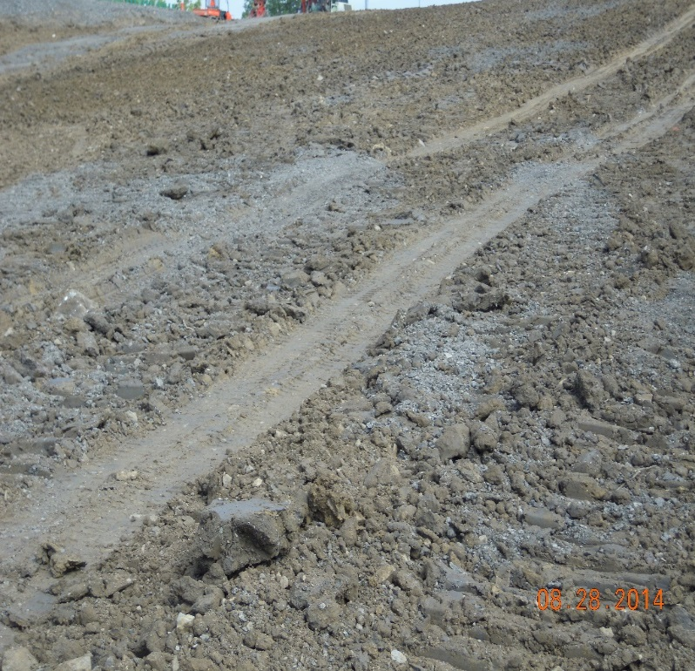
Roadway Excavation And Embankment
Fill surface sloped for runoff drainage
Seepage drainage control added
Acceptable compaction
  testing procedures
Excess millings mixed into fill
Construction drains added to collect seepage

Slide 19
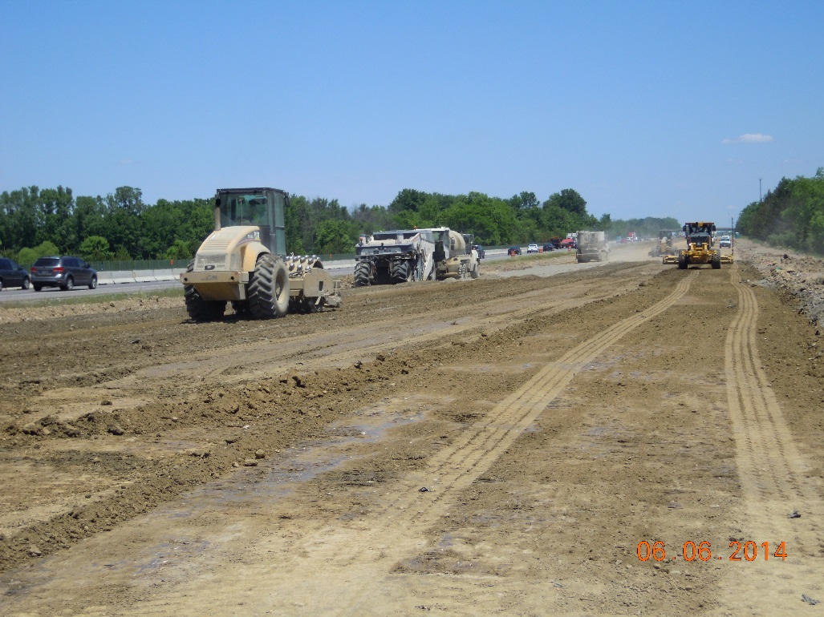
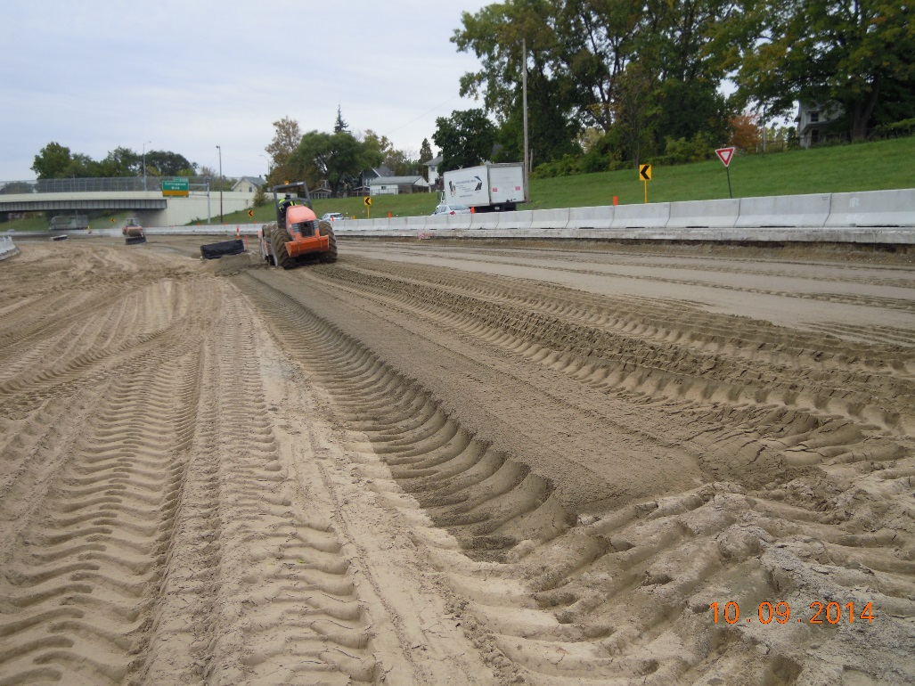
Item 206 – Chemically Stabilized Subgrade
6 Interstate reconstruction projects
Good compliance with specification
  Curing coat application problems
  Stabilization at phase interface

Slide 20
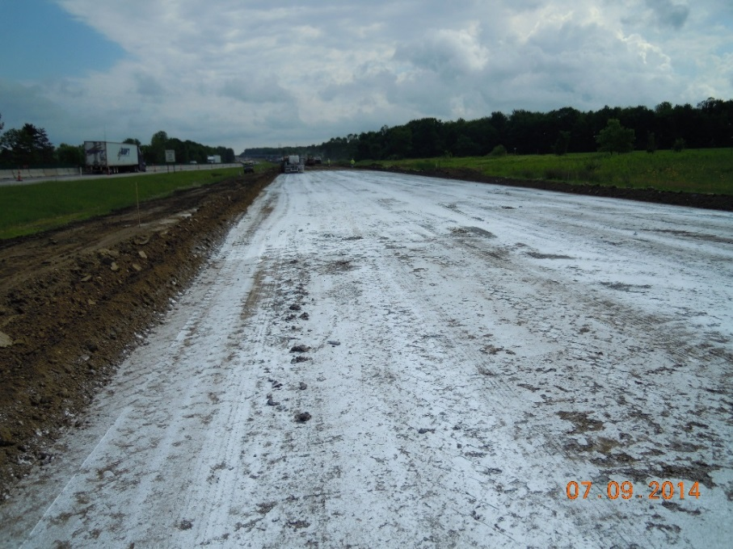
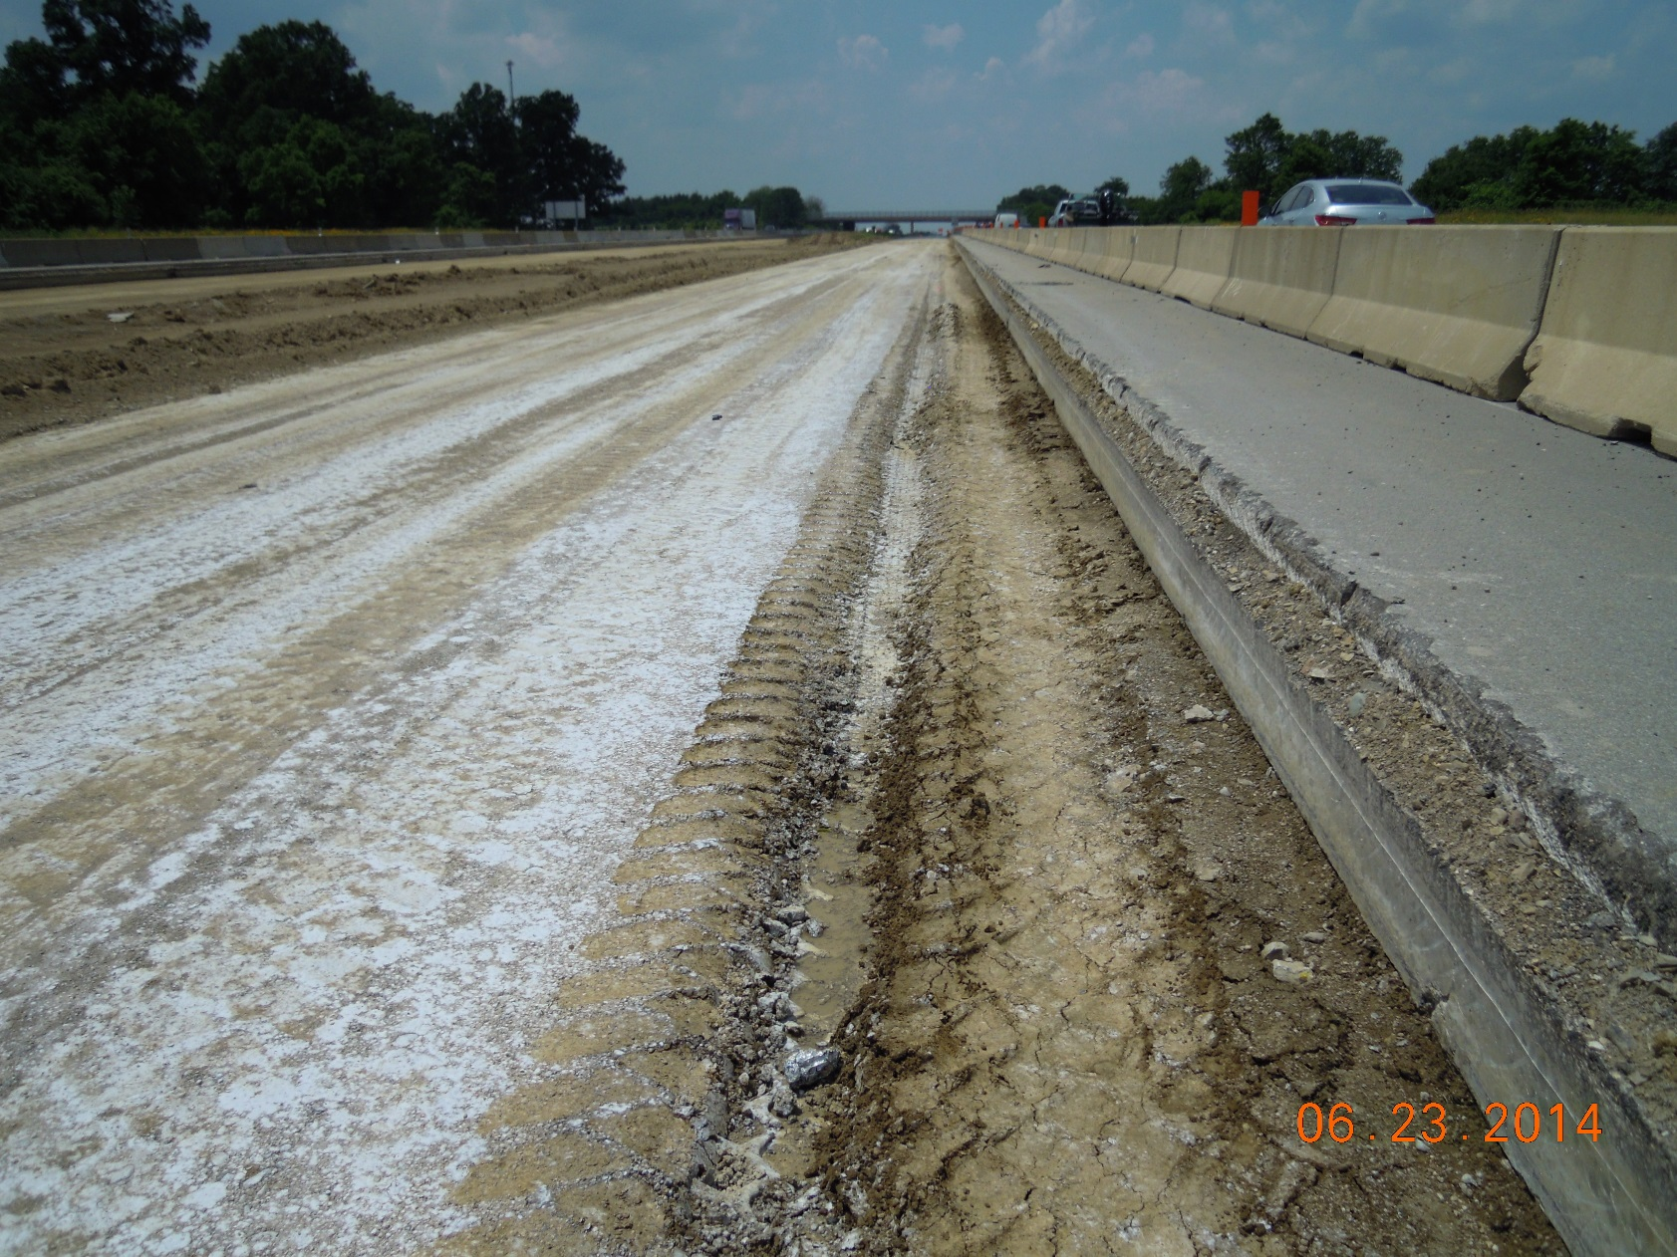
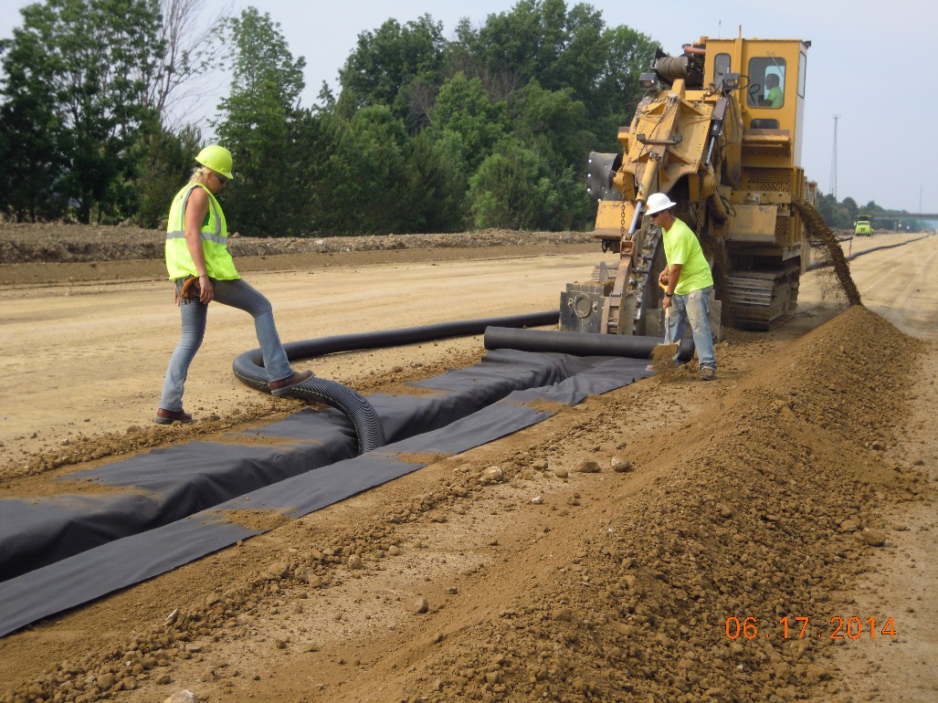
Chemically Stabilized Subgrade
Curing Coat Application
Fairly
Uniform
Uneven or Spotty
Not Apparent

Slide 21
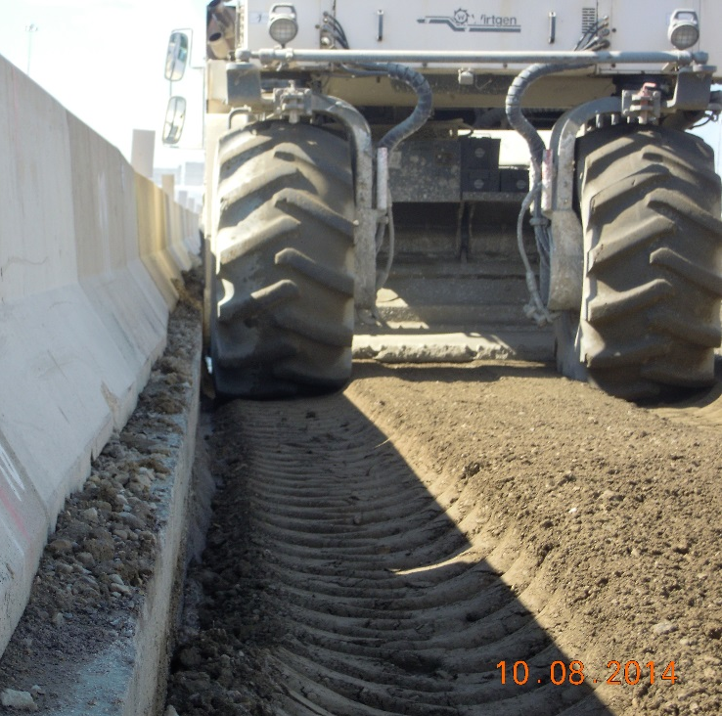
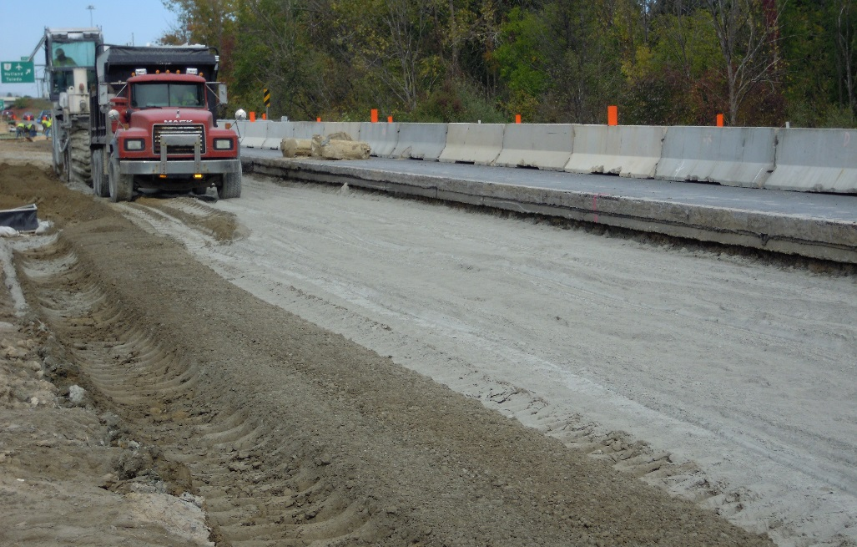
Chemically Stabilized Subgrade
Treatment at phase line
Stabilizer cannot get all the way to the edge of existing pavement
If space permits, overlapping can be provided

Slide 22
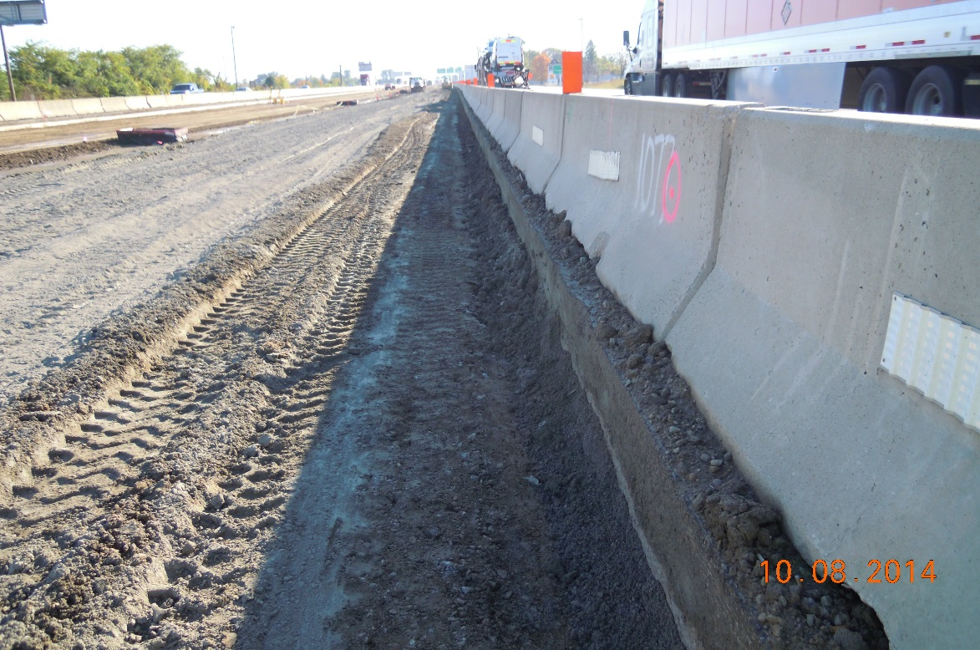
Chemically Stabilized Subgrade
Treatment at phase line
  Cement spread to pavement edge
  Grader or dozer digs out material at edge
  Stabilizer blends as close as possible
  Return blended material back and compact

Slide 23
Chemically Stabilized Subgrade
206.03 Submittals. Submit for the Engineer’s acceptance a report that lists the type of equipment to be used, speed of the intended equipment usage, rate of application of the chemical, and calculations that demonstrate how the required percentage of chemical will be applied. For phased work, list in the report the procedure to be used to construct the chemically stabilized subgrade to ensure full depth and continuity across phase interfaces….Department acceptance of the report is not required. The absence of Department acceptance does not supersede the Engineer’s authority as defined in 105.01
206.05 Construction. Added the following:
Where phasing for maintenance of traffic uses part width stabilization of the subgrade, ensure that the required chemical spreading rate, mixing depth, and compaction are provided at the interface between adjacent phases

Slide 24
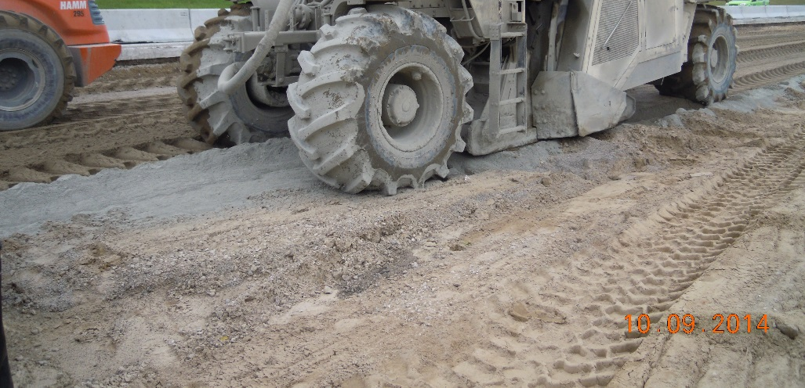
Unique Subgrade Condition
Subgrade consisted of Fine Sand
Treatment 16-in deep with 6.5% cement
Grading equipment could not get smooth surface on the day of treatment
Allowed to set for a day, then performed grading and cure coat

Slide 25
Chemically Stabilized Subgrade
Random sampling of subgrade for mix design
Biased sampling where easiest to obtain
  From median, below shoulder, ignore phasing
S 1120 revised January 2015
When this supplement is used during construction for stabilizing subgrade (Item 206), collect samples of in-place soil at the proposed subgrade elevation. …For in-place soil samples, collect the samples from locations distributed across the treated area. For phased construction, collect in-place soil samples from locations distributed across the treated area of each phase at the frequency given above. Obtain the Department’s approval before collecting samples from outside the treated area

Slide 26
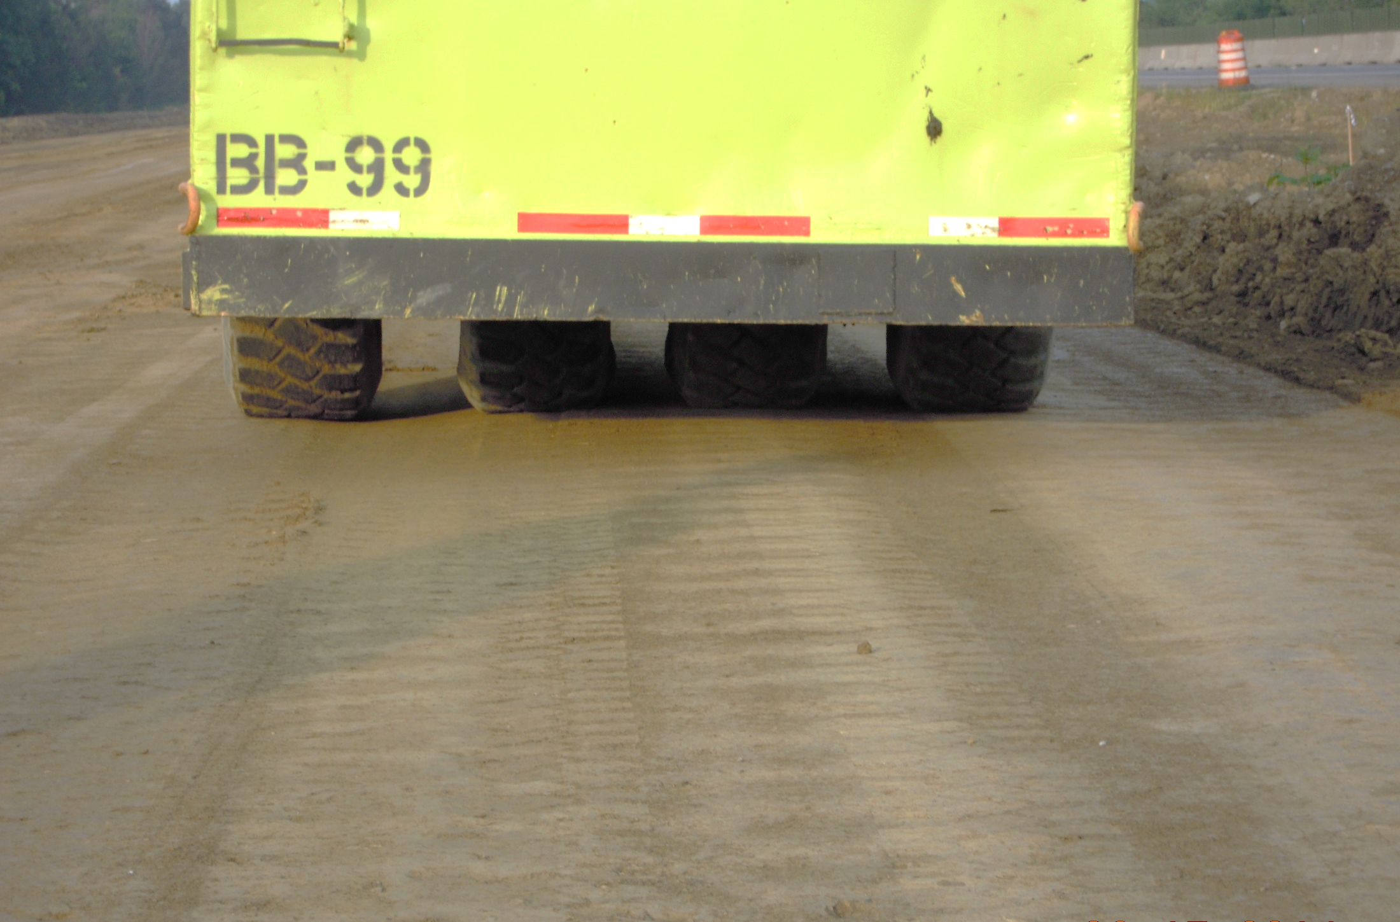
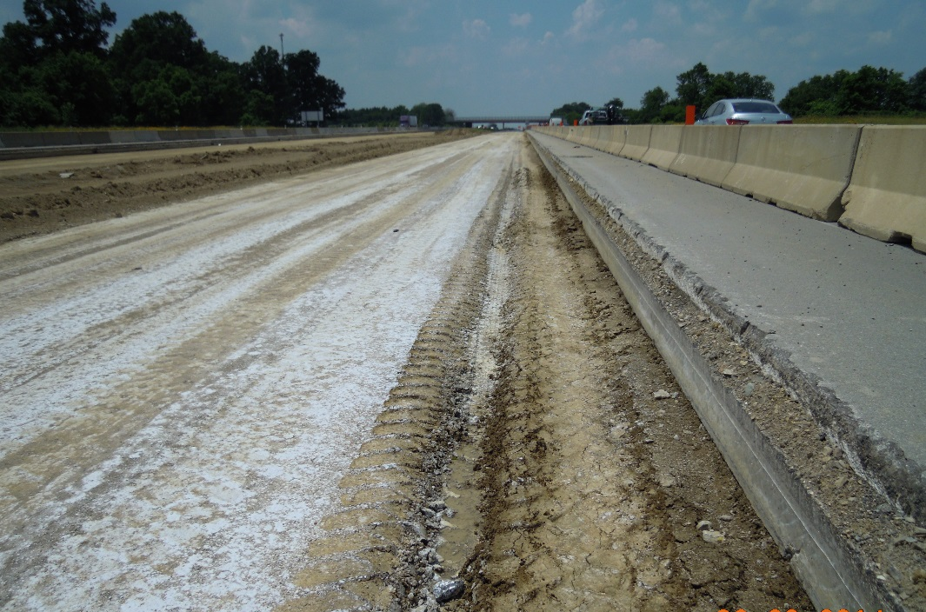
Item 204 – Proof Rolling
3 Interstate reconstruction projects
Cement stabilized subgrade, 12” & 14”
35^{T} roller observed by ODOT or consultant
No rutting; except along the phase line at existing pavement, ~1400-ft section

Slide 27
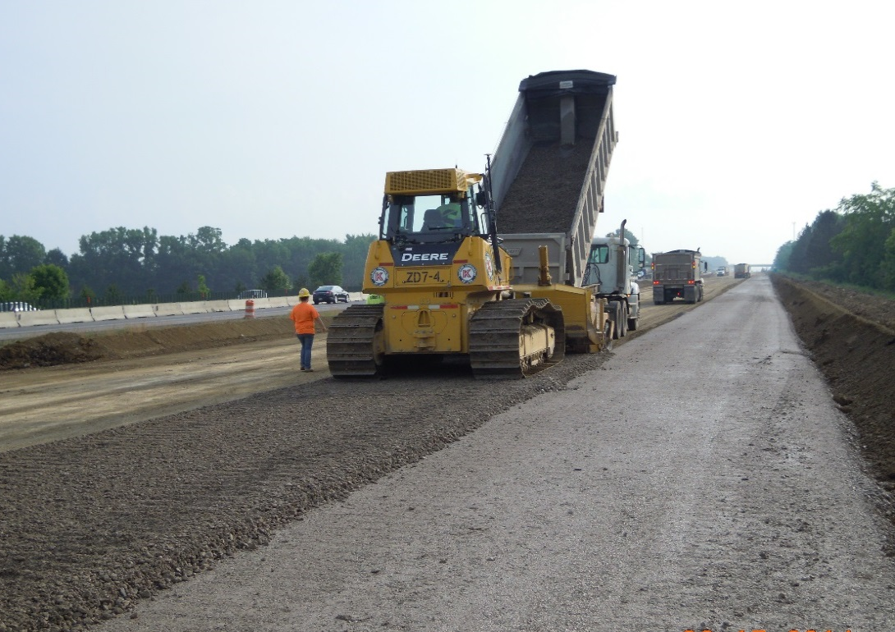
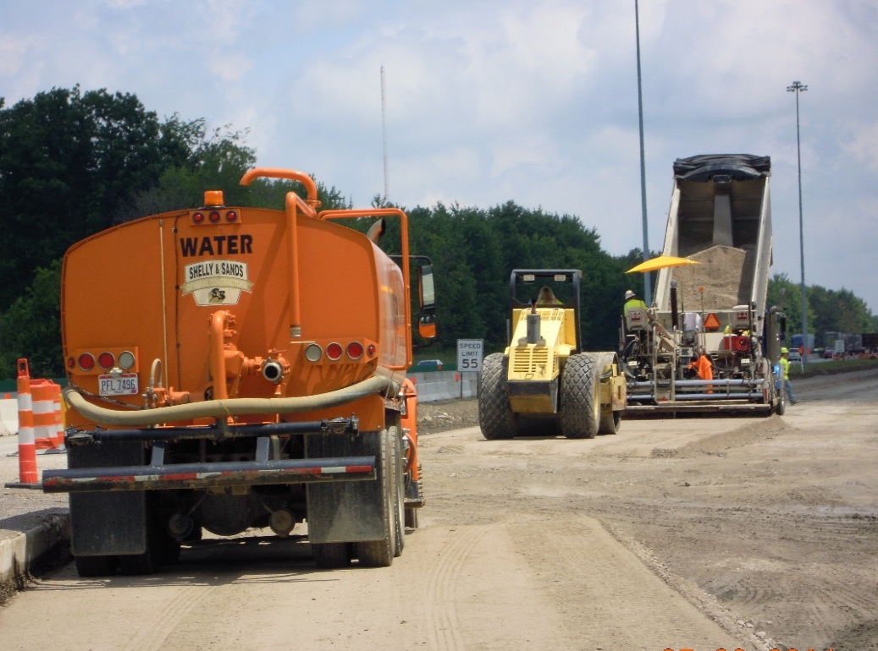
Item 304 – Aggregate Base
2 Interstate reconstruction projects
Spreader box and self-propelled paver
No segregation observed
Correct final thicknesses & compaction

Slide 28
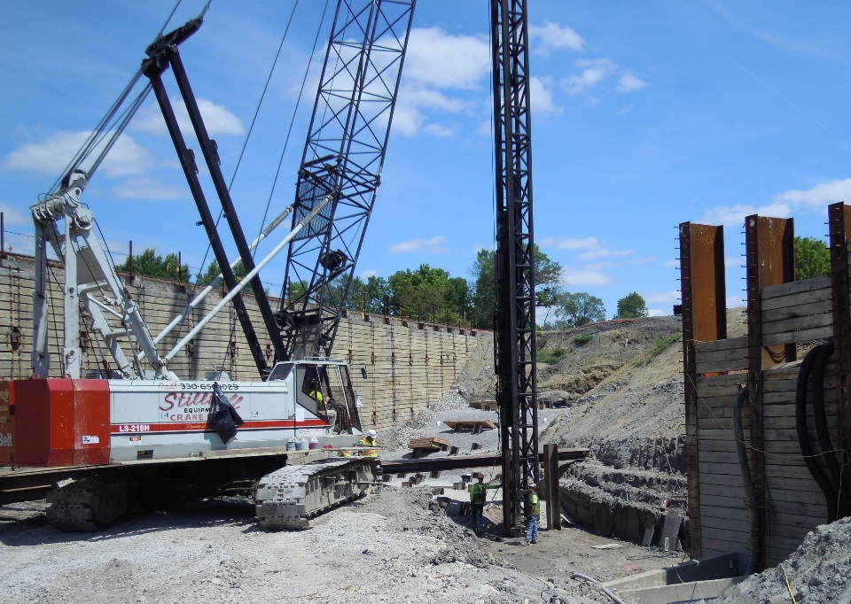
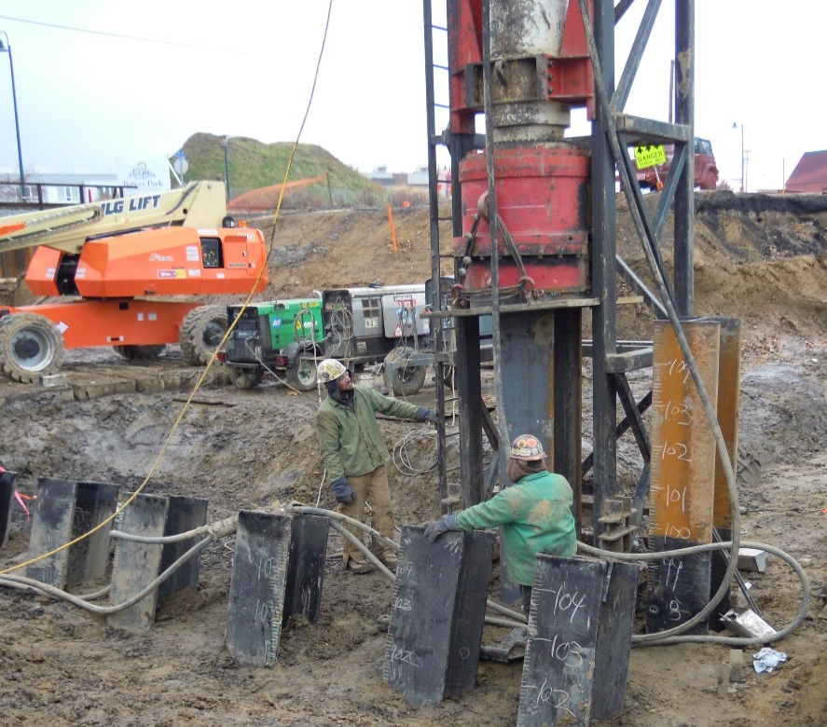
Item 507 – Bearing Piles
2 Railroad Underpass Projects
HP 14x73
Length 75 to 80 feet
Bedrock refusal required
Piles installed in 70-foot prebored holes
HP 18x204
Length ~100 feet
Hydraulic hammer
1.5*UBV = 940 kips
20 blows/inch @ 44 kip-ft.

Slide 29
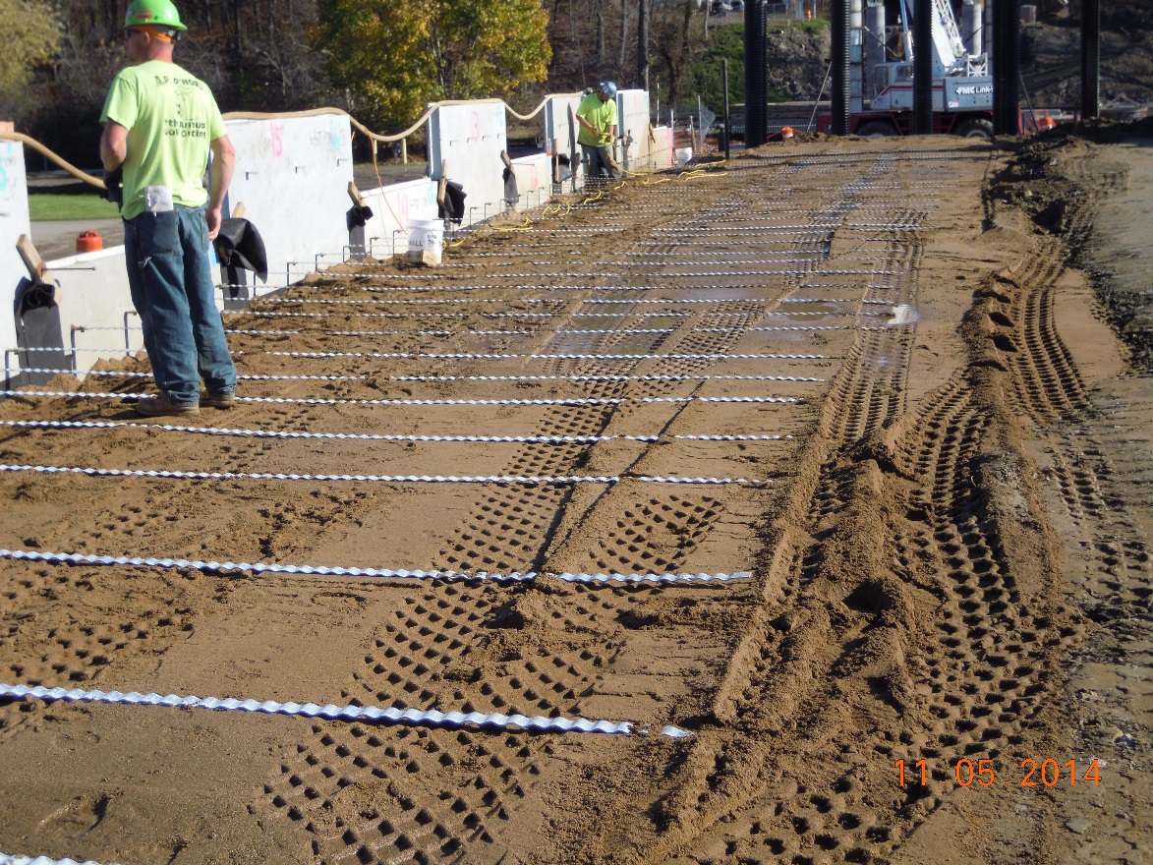
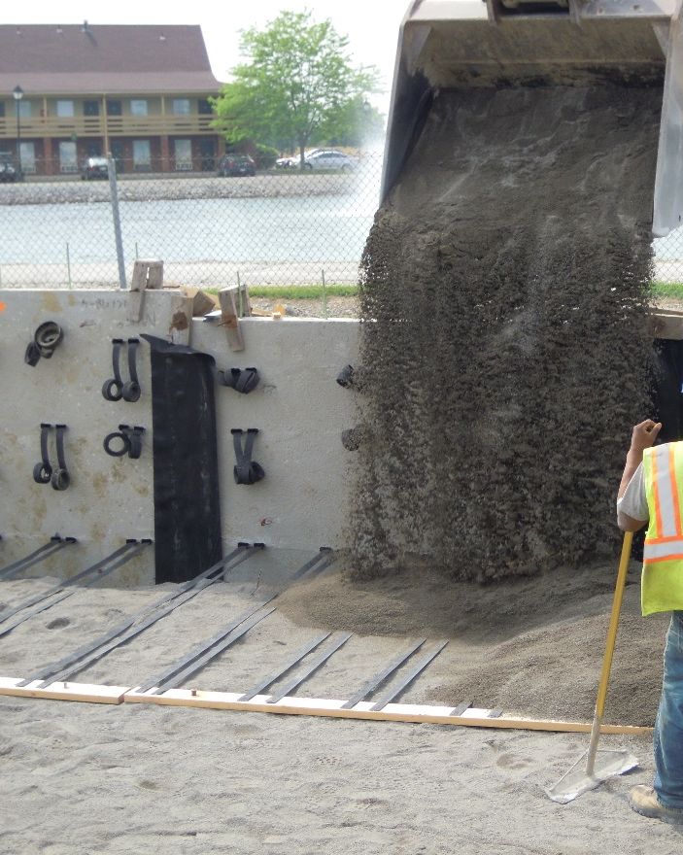
Item 840 – Mechanically Stabilized Earth Wall
3 Projects - different systems & contractors
Panel & joint alignment common issues

Slide 30
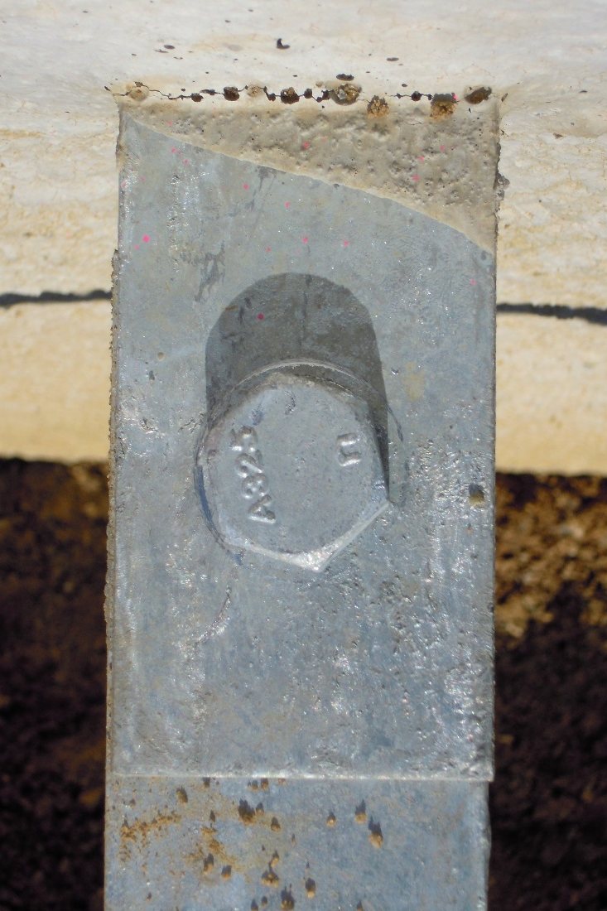
Mechanically Stabilized Earth Wall
Bolts inserted from top
  Can’t see nut
  Connection must be bolted not pinned
No washer below bolt
  Protects galvanization from tools

Slide 31
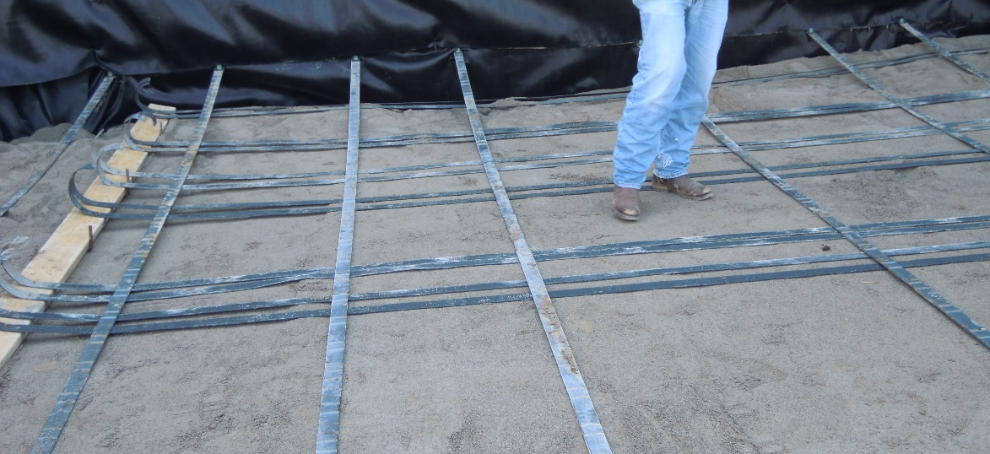
Mechanically Stabilized Earth Wall
Temporary steel reinforcements crossing permanent geosynthetic straps
  Potential for damage to permanent wall
Shop drawings submitted separately and only showed one wall system

Slide 32
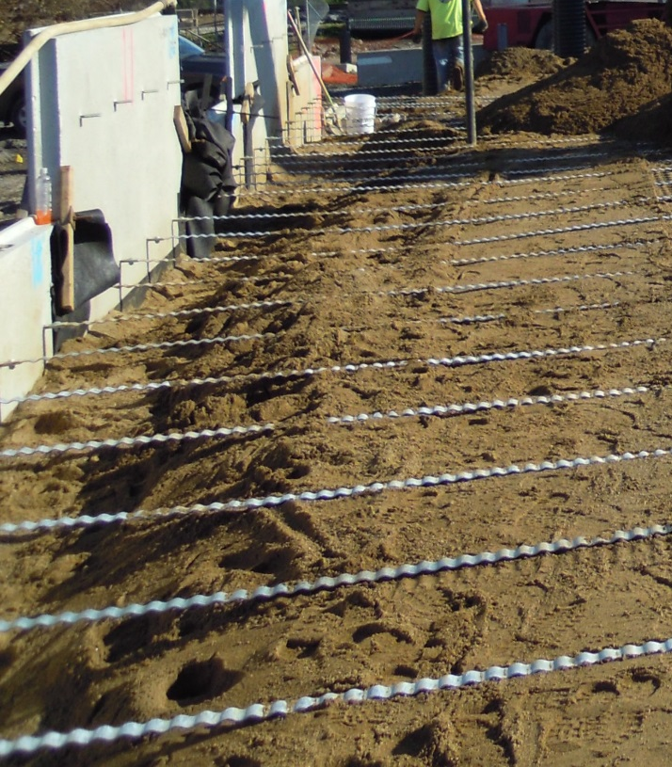
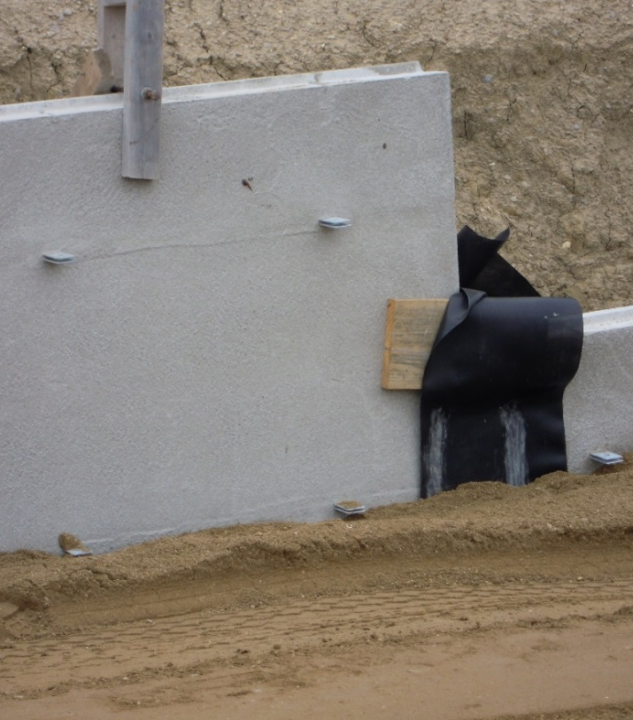
Mechanically Stabilized Earth Wall
Backfill placement behind facing panel
  Extend horizontally to back of panel
  Space provided only at lowest row to prevent kick-out of bottom panel
Incorrect
Correct level

Slide 33
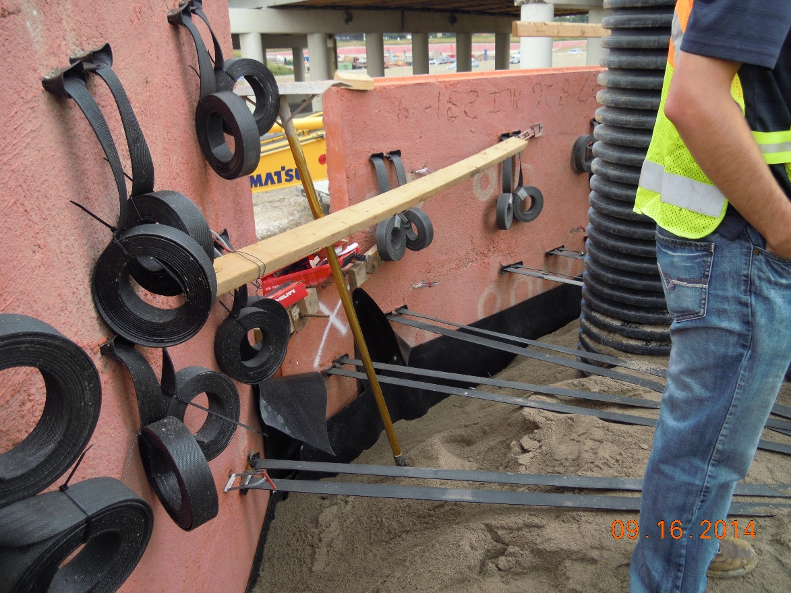
Mechanically Stabilized Earth Wall
Geotextile power-nailed to panel
For this system, fill at panel once reinforcement has been covered

Slide 34
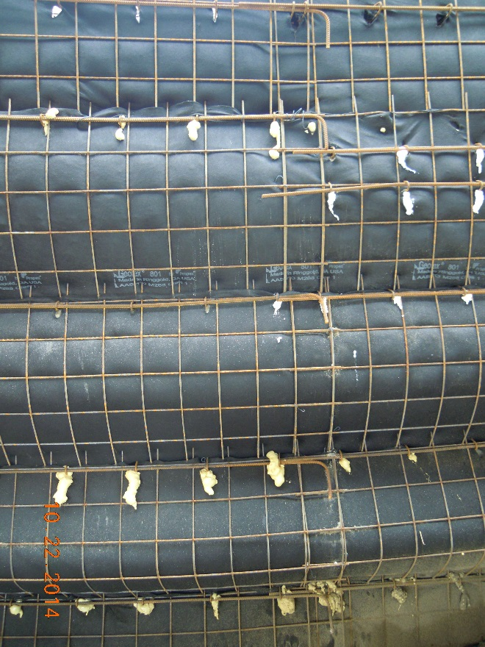
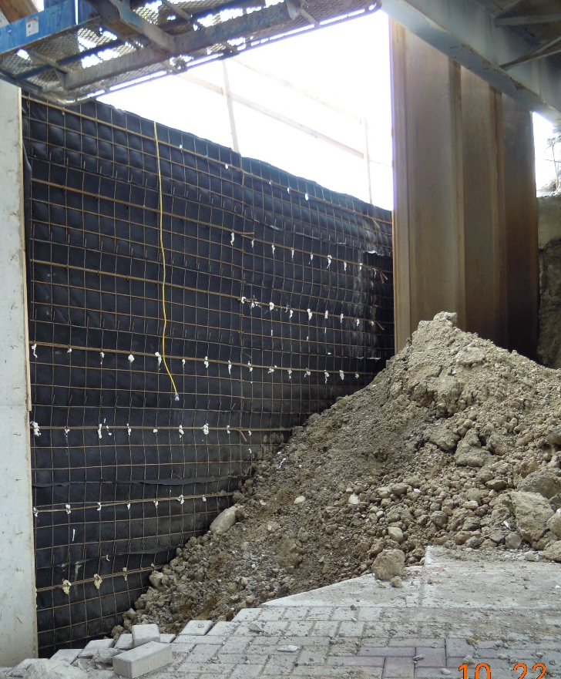
Mechanically Stabilized Earth Wall
Temporary welded wire-faced walls
Overlap of facing panels
No overlap ⇨ Bulging
Correct Overlap

Slide 35
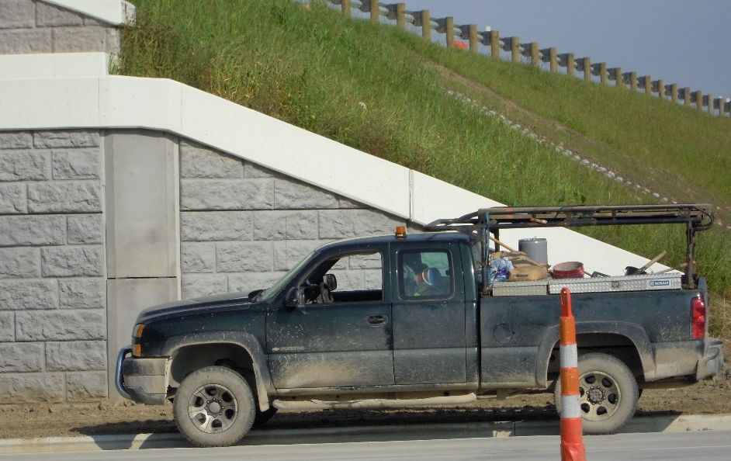
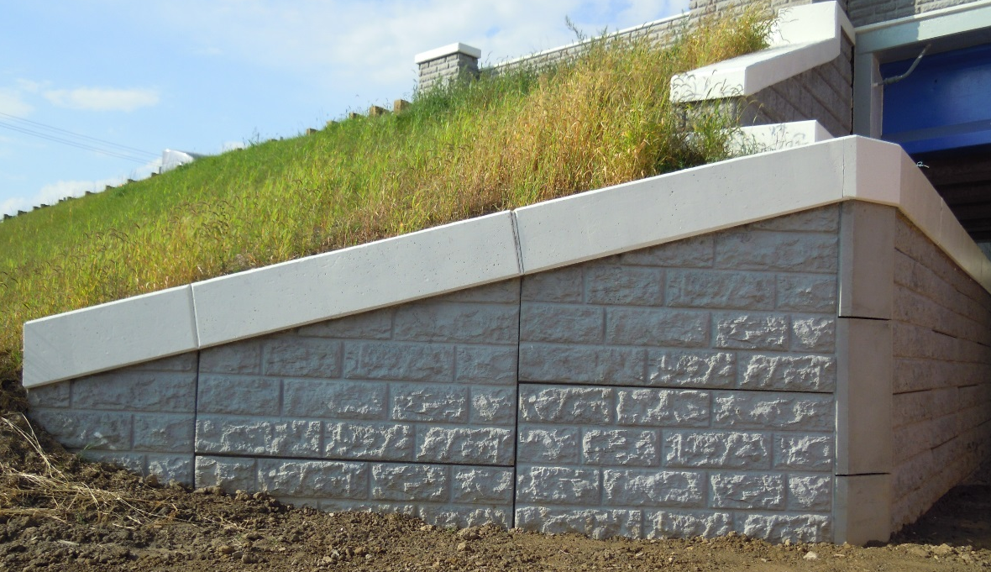
Mechanically Stabilized Earth Wall
Coping joints – vertical, aligned with panels
  ⬅ Vertical & aligned
  Aligned, but not vertical ➔ Continuous around corner, but saw cut above corner

Slide 36
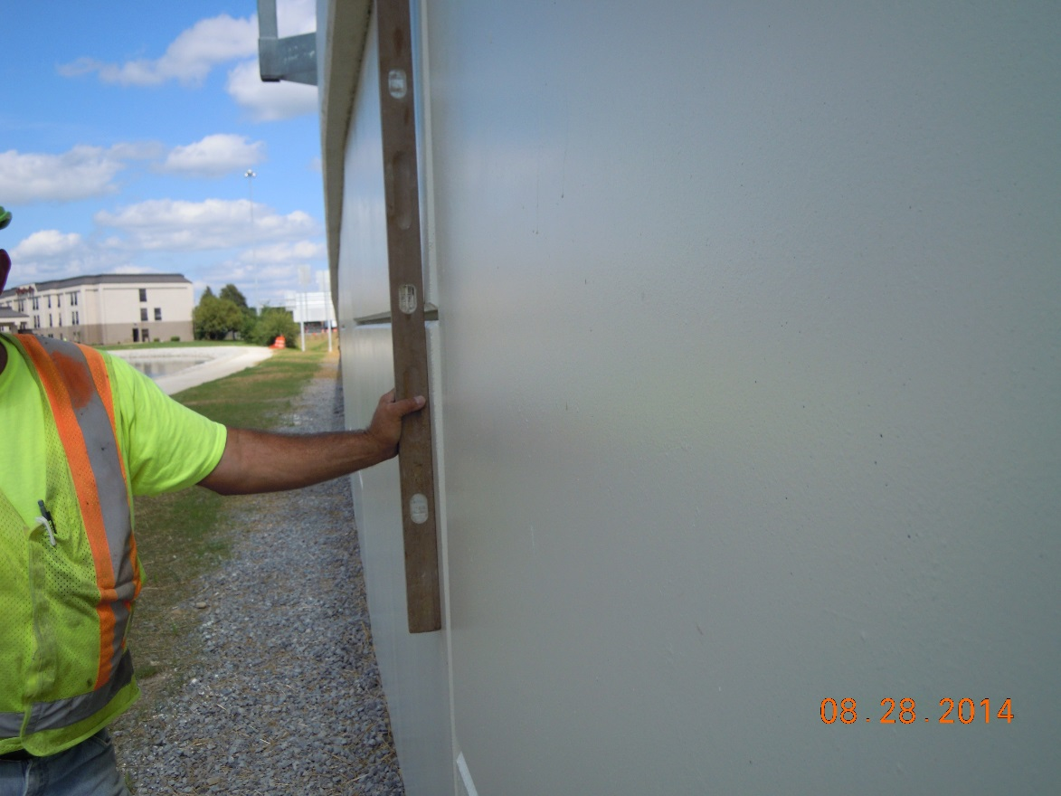
Mechanically Stabilized Earth Wall
Only bad joint in 500 foot long wall at beginning of radius. 1 inch out of plumb

Slide 37
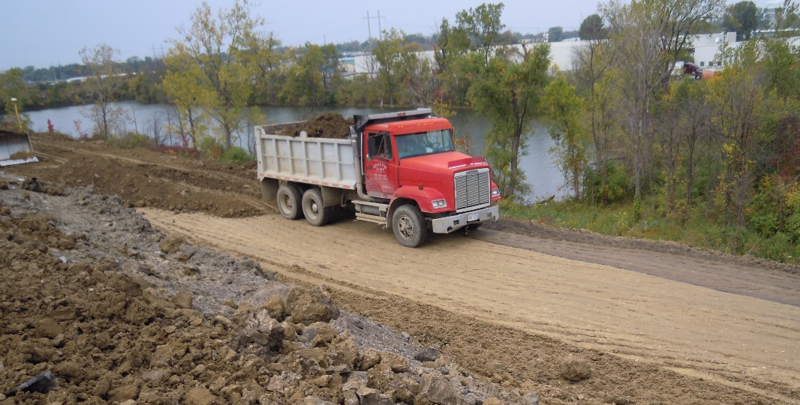
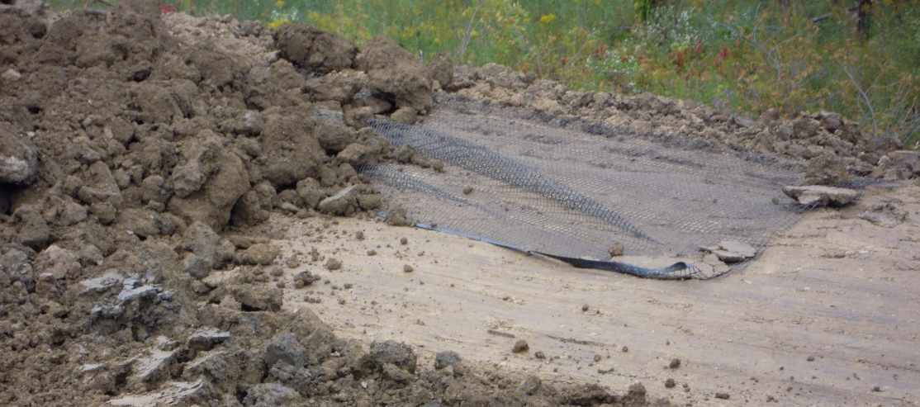
Item 863 - Reinforced Soil Slope
Project – Interchange reconstruction with limited R.O.W. (VECP)
⬅ Trucks driving on geogrid
⬅ Geogrid folded & wrinkled

Slide 38
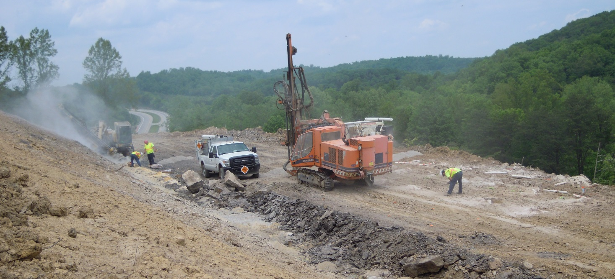
Item 208 – Rock Blasting
Project – layback rock slopes
Presplit & production blasting
Blasting Plan submitted
Observed work followed the Plan

Slide 39
Pavement Technical Process Reviews
Craig Landefeld, P.E.
Construction Pavement Engineer

Slide 40
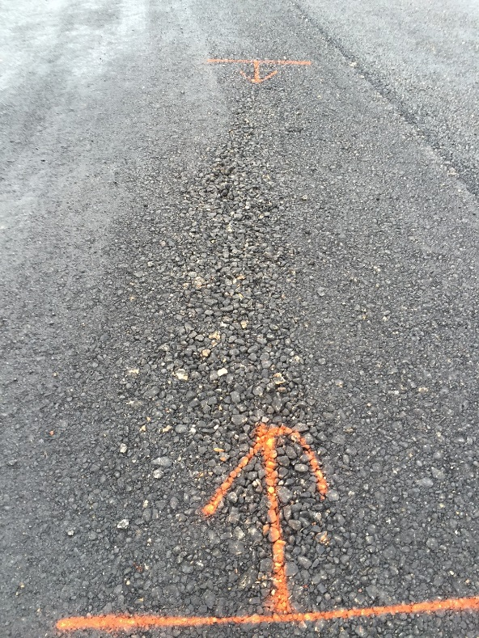
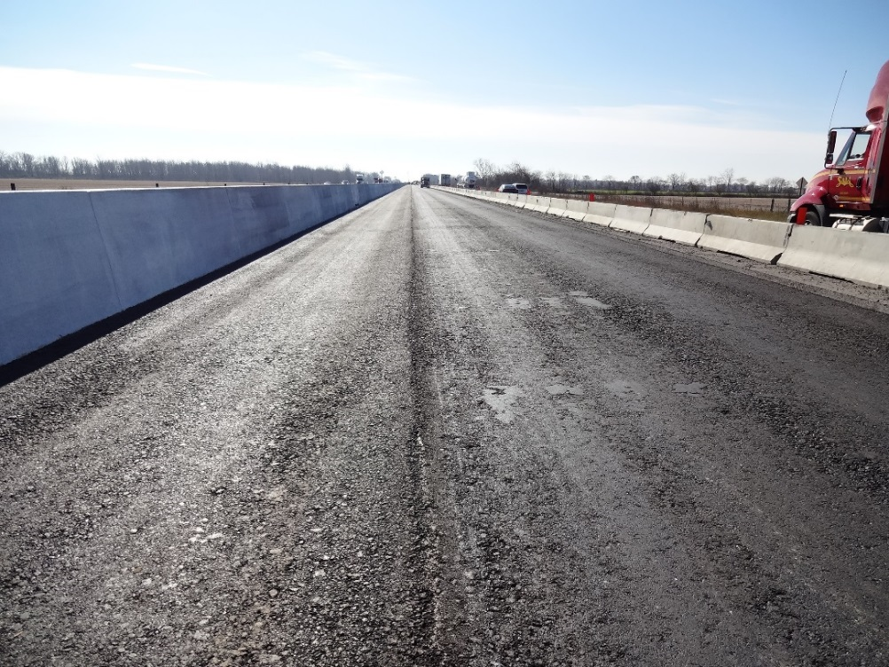
Segregation
Reduces Fatigue Life of Pavement
Stripping increased
Future repairs
Does not meet CMS 401.15
Contractor should correct
Notes:
Pavement fatigue life is drastically reduced by segregation.
Stripping will result from water laying in the voids
Repairs will be required to go the depth of the issue
Contractor can prevent this issue
ODOT must reject this work immediately and require repairs. ** DO NOT LET THE ISSUE GO ON FOR DAYS!!!

Slide 41

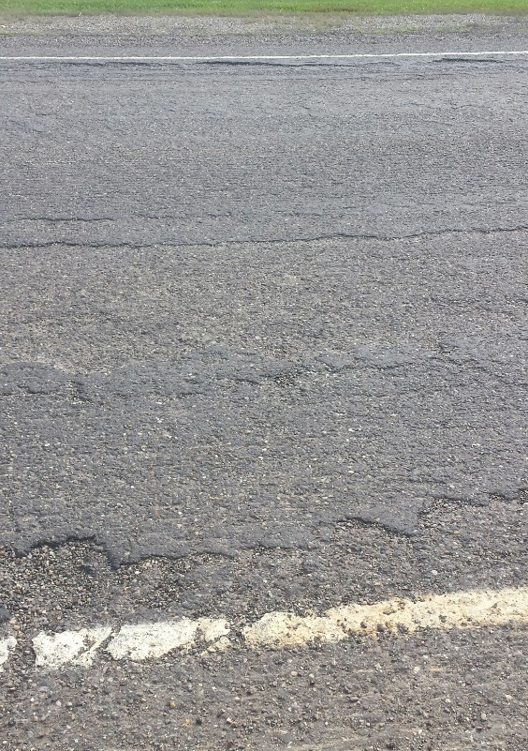
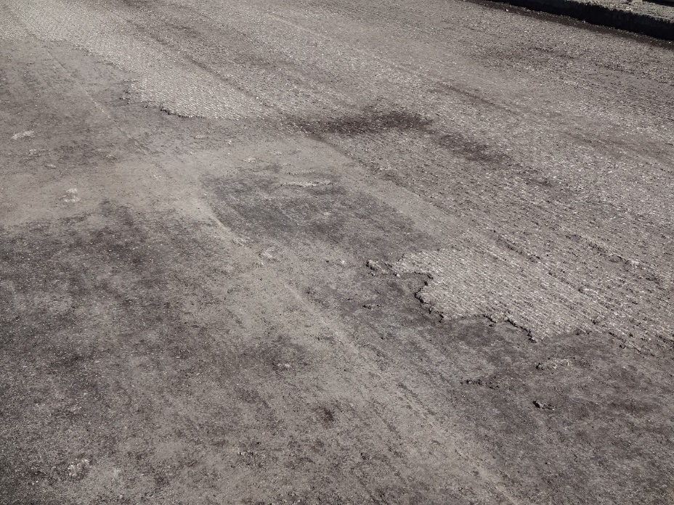
Scabbing
Reduces ability to obtain desired density
May result in delamination and/or fatigue failures
CMS 254.07 Allows for 3/8in increase in depth
Notes:
This issue needs to be addressed future failures will result.
254.07 allows for a 3/8” increase in depth at not additional cost
Contractor’s and ODOT need to address this issue.

Slide 42
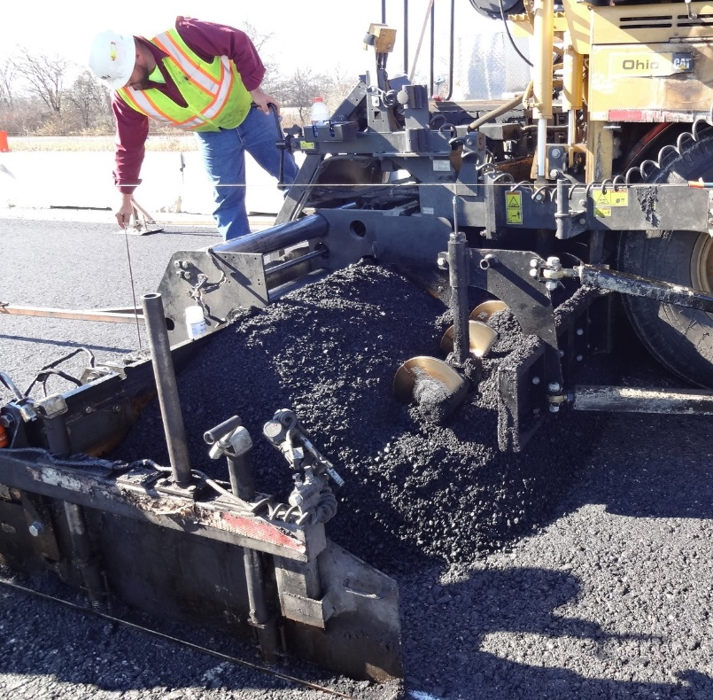
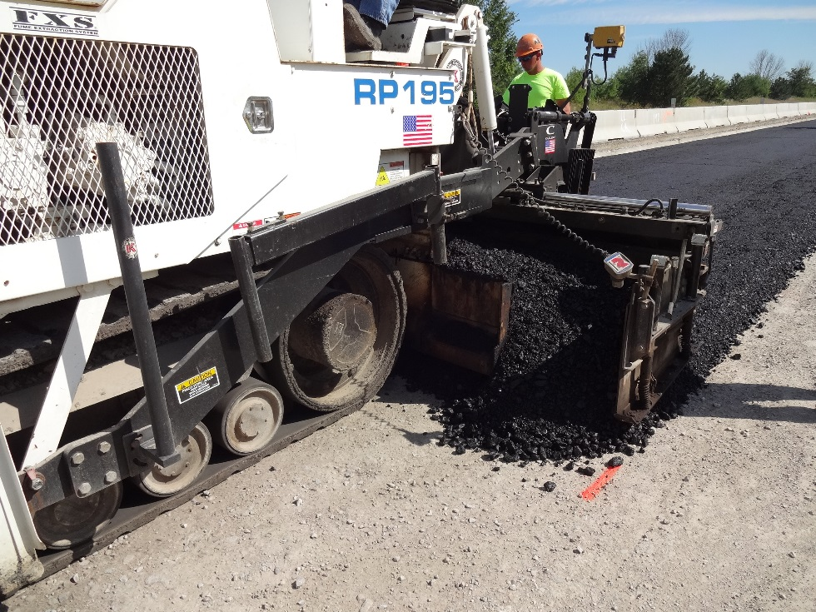
Auger / Tunnel Extensions
Excess Head on screed
No Auger/Tunnel Extensions
Side plates not containing material
Does not meet CMS 401.15
Notes:
401.15 requires containment, auger tunnel extensions, heating etc..

Slide 43

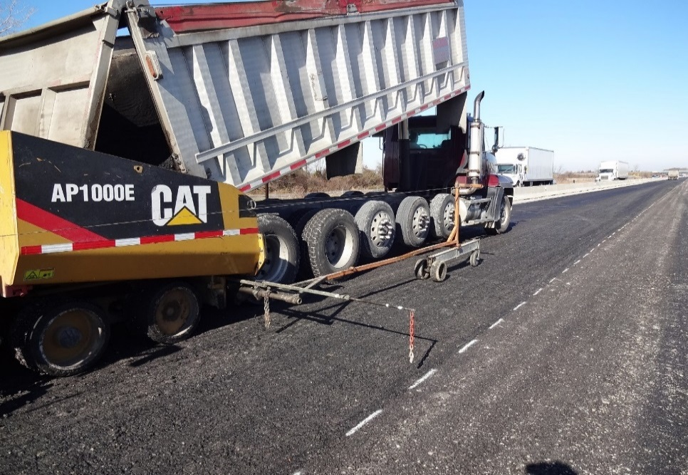
401.17 Longitudinal Joints
SS800 – July 19, 2013
“Construct longitudinal joints using string line or other controls as a point of reference to provide a straight longitudinal joint. Prior to placing adjacent pavement, trim any locations along the longitudinal joint that deviate horizontally from the point of reference. Maintain a consistent overlap of 1 inch to 1 ½ inches on adjacent pavement when closing longitudinal joints.”

Slide 44
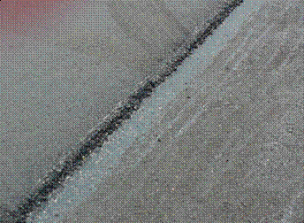
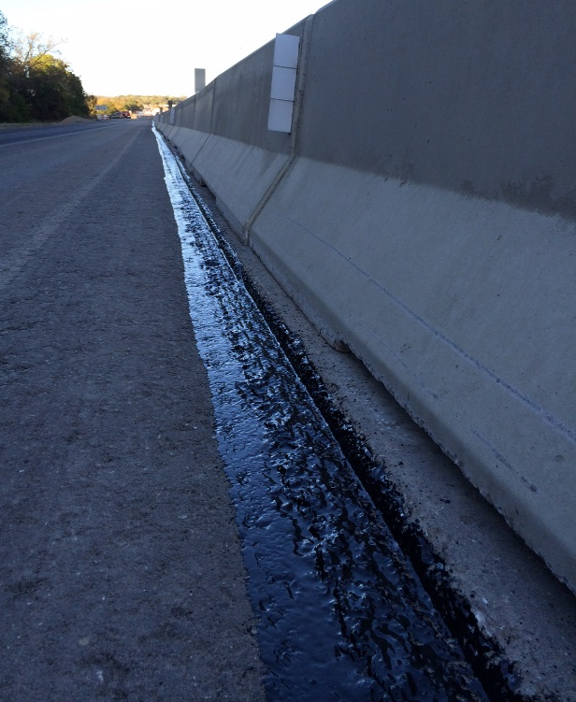
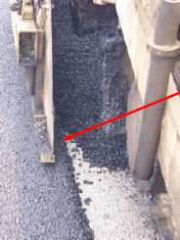
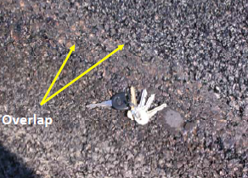
401.17 Longitudinal Joints
Trimming is required before closing joint
Seal joint with PG Binder or Joint Adhesive (NO TACK COAT)
1-1.5 inch overlap is required

Slide 45
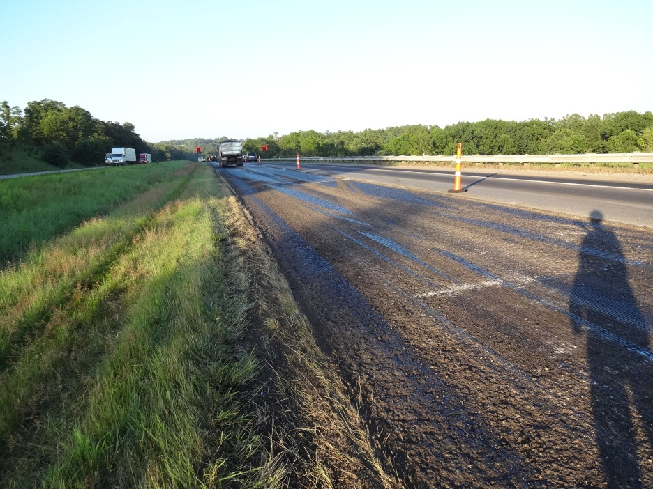
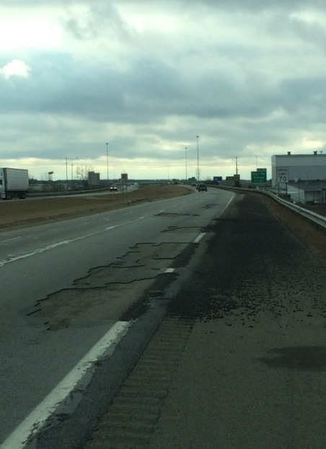
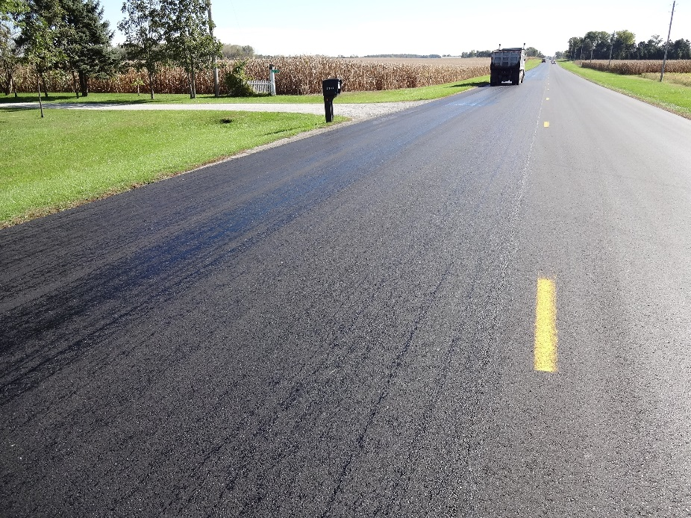

407 Tack Coat
Allow tack time to break
Make operational or material changes
PIF Extended for Trackless Tack
NCAT Tack Coat Study 05-08
Poor tack applications may show up as delamination
Premature fatigue cracking
Notes:
Tack needs to be thought about before job sale – Night work/ Limited Closure /Access – Should I use Trackless Tack or will SS-1h work
Contractor must give tack a chance to break – recent studies show 2hrs is the ideal time for SS-1h
Consider trackless tack change if you cant keep the tack in place
- NCAT study concluded that pavement fatigue life is reduced by ~50% from a 10% reduction in the tack bond strength from fully bonded.
- Poor tack applications may show up as delamination.
- I75 placed in 2007
- Delamination began in 2010 – Spot paving
- Milled off in 2013
- Poor tack applications may also show up as premature fatigue cracking.
- Looking to perform research in 2014-15

Slide 46


Questions??
Craig Landefeld, PE
Phone: (614) 644-6622
Email: craig.landefeld@dot.state.oh.us

Slide 47
Documentation Technical Process Reviews
Scott Hootman
Transportation Manager
(614) 387-3207
Scott.Hootman@dot.state.oh.us

Slide 48
Documentation Technical Process Review
Who’s Reviewed:
5 projects per District per year
What’s Reviewed:
Documentation of work performed in the field
Estimates
Materials
SiteManager Data Entry
SharePoint Website
Finalization Process
When Reviewed:
Technical Process Reviews are performed May through October

Slide 49
Documentation Technical Process Review
2014 TPR Results
          Issues:
MCR 58%
Missing Key Dates 22%
Missing Docs Forms 22%
Pre-con held before Signed Contract 7%
Missing CA-D-11 13%
Missing Asphalt Tickets 2%
Not using SharePoint 3%
Missing Materials 2%

Slide 50
Change Order and Specifications
Merka Flynn
Program Manager
(614) 752-9018
Merka.Flynn@dot.state.oh.us

Slide 51
Change Order – 2014 Summary
188 requests were processed for Over Contract Limit Work
111 Non-Retroactive requests
77 Retroactive requests

Slide 52
Value of Change Order Requests Over Contract Limits – 2014

Slide 53
Specification Update
Quarterly specifications will be issued throughout 2015
ODOT will be working on the Draft 2016 C&MS and MOP through out this year
Contact the appropriate Specification Chair for updated schedules and information

